Slide 1
T24 Sharing and Knowledge Transfer
AMK, 16,17,23,24-Febuary-2019

Slide 2
Agenda
No | Course | Description | Time | Total Time
1 | Fundamental T24 Code Concept | A. T24 Code Convention B. Variable Data Structure C. Jbasic Code Introduction D. T24 Code Function Introduction | a. 1 hours b. 1 hour c. 6 hours d. 3 hours | 11 hours
2 | Enquiry Customization | A. Enquiry Definition B. Enquiry Routine C. Enquiry Routine in Browser | a. 1 hour b. 2 hours c. 2 hours | 5 hours
3 | Batch Job Customization | A. Single Thread batch job Introduction B. Basic rule for batch job coding C. Multi Thread batch job Introduction | a. 3 hours b. 2 hours c. 4 hours | 9 hours
4 | T24 System Configuration | A. Basic system concat file introduction | a. 2 hours | 2 hours
5 | Open Financial Service (OFS), develop API | A.OFS Introduction and Structure | a. 2 hours | 2 hours
 |  |  | Total Time : | 29 hours

Slide 3
Fundamental T24 Code Concept
T24 Code Convention
The code convention is nothing but a certain rule for naming – includes object & routine & variables
Why we need the code convention?
Easy to understand the meaning and purpose
Long term maintenance consideration
Global Variables
Global variables are defined in I_COMMON.
Example:
I_LN.DISB.RMSB.COMM

Slide 4
Fundamental T24 Code Concept(Cont.)
* Modification History :
* ======================
* Modify.Ref Modified.By Date.of.Change Change.Details
*-----------------------------------------------------------------------------
*-----------------------------------------------------------------------------
COMMON/LN.DISB.RMSB/
FN.LD,
F.LD,
FN.ACCT,
F.ACCT,
* 2015-09-02 - ld.hist.rec.update - S
FN.LD.HIS,
F.LD.HIS,
FN.LM.BAL.HIS,
F.LM.BAL.HIS,
EQU TXN.TYPE.DISB TO 'DISB',
TXN.TYPE.RMSB TO 'RMSB',
TXN.TYPE.OTH TO 'OTH'

Slide 5
Fundamental T24 Code Concept(Cont.)
- Standard Variables
Where filename is the exact name of the file. Filename variables should only be used when required.
normally a constant should be used e.g. CALL OPF(‘F.ACCOUNT’, F.ACCOUNT).
Subroutine Names and Variables
Subroutine names and variable names should be in upper case and should be as long as necessary to describe their purpose. However
subroutine names are limited to 35 characters.
Example:
* Modification History :
* ======================
* Modify.Ref Modified.By Date.of.Change Change.Details
*-----------------------------------------------------------------------------
SUBROUTINE <Name>
RETURN
 |  | Example
File Variable | F.filename | F.ACCOUNT
File Name | FN.filename | FN.ACCOUNT
Record Value | R.filename | R.ACCOUNT

Slide 6
Fundamental T24 Code Concept(Cont.)
* Modification History :
* ======================
* Modify.Ref Modified.By Date.of.Change Change.Details
*-----------------------------------------------------------------------------
SUBROUTINE AMR.GET.VDESC(YDATA)
$INSERT T24.BP I_COMMON
$INSERT T24.BP I_EQUATE
$INSERT T24.BP I_F.VERSION
YVERSION = APPLICATION:PGM.VERSION
FN.VERSION = "F.VERSION"
F.VERSION = ''
CALL OPF(FN.VERSION,F.VERSION)
CALL F.READ(FN.VERSION,YVERSION,R.VER,F.VERSION,YRR)
IF R.VER THEN
YDATA = R.VER<EB.VER.DESCRIPTION>
END
RETURN
PROGRAM <Name>
END

Slide 7
Fundamental T24 Code Concept(Cont.)
* Modification History :
* ======================
* Modify.Ref Modified.By Date.of.Change Change.Details
*-----------------------------------------------------------------------------
PLROGRAM PRG.EXT.DATA.CUST.INFO
$INSERT T24.BP I_F.DEPT.ACCT.OFFICER
CALL LOAD.COMPANY('BNK')
FN.DAO = 'F.DEPT.ACCT.OFFICER'
F.DAO = ''
CALL OPF (FN.DAO,F.DAO)
SEL.CMD = ' SELECT ':FN.DAO
CALL EB.READLIST(SEL.CMD, DAO.LIST, '', LP.DAO.MAX,'')
FOR LP.IDX = 1 TO LP.DAO.MAX
CRT ' Dept Account Officer ID : ' : DAO.LIST<LP.IDX>
NEXT LP.IDX
END

Slide 8
Fundamental T24 Code Concept(Cont.)
B. Variable Data Structure
The variable type declaration is not required in the T24 code – because all variables are “Variant” type data.
The “Variant” type data could be “string” & “numeric” & “integer” & “long” & “boolean” …etc
Example:
DATE.CURR = current date
LP.IDX = for next loop index
LP.MAX = for next loop index max
Delimiter For Dynamic Array
There are 3 major types of delimiter have been used in the T24 code.
FM = field marker
VM = value marker
SM = sub-value marker
Example:
TU.TMP.VAL = 'A‘ :@FM: 'B‘ :@FM: 'C‘ :@FM: 'D‘ :@VM: '1‘ :@VM: '2' :@VM: '3' :@FM: 'F' :@SM: 'G' :@SM: 'H' :@SM: 'I‘
Result: AþBþCþDý1ý2ý3þFüGüHüI

Slide 9
Fundamental T24 Code Concept(Cont.)
C. Jbasic Code Introduction
Function | Description | Example
[x,y] | sub-set for the string X is the starting position Y is the length for sub-set | DATA = '1234567890' DATA[1,2] -> '12' DATA[3,4] -> '3456'
<X,Y,Z> | get the data element from the FM & VM & SM | DATA = 'ABC' :@FM:'DEF' :@FM:'GHI' DATA<1> -> 'ABC' DATA<3> -> 'GHI' --------------------------------------------- DATA ='ABC' :@VM:'A1' :@FM:'DEF' :@VM:'D1' :@FM:'GHI' :@VM:'G1' DATA<1,1> -> 'ABC' DATA<1,2> -> 'A1' DATA<2,1> -> 'DEF' DATA<2,2> -> 'D1' ------------------------------------------------ DATA = 'ABC' :@SM:'AS1' :@VM:'DEF' :@SM:'DS1' :@FM:'GHI' DATA<1,1,1> -> 'ABC' DATA<1,1,2> -> 'AS1' DATA<1,2,1> -> 'DEF' DATA<1,2,2> -> 'DS1' DATA<2,1> -> 'GHI' DATA<2,2> -> ''

Slide 10
Fundamental T24 Code Concept(Cont.)
ABS | absolute value | POS.VALUE = ABS(10-15)
CALL | call to other routine | CALL OTHER.SUB() CALL OTHER.SUB(PARAM1,PARAM2)
CHANGE | change the original char to another char | CHG.BEF = 'ABCDEF' CHANGE 'F' TO 'H' IN CHG.BEF 'ABCDEF' -> 'ABCDEH'
OPENSEQ | open the sequential file (text file) | OPENSEQ XXX,YYY TO PPP THEN (logic for a successful opening) END ELSE (logic for a fail opening) END XXX -> directory name YYY -> file name PPP -> file pointer for later usage Example: WRITEFILE='DAO.TXT' OUTPUT.DIR='EXTRACT.BP' OPENSEQ OUTPUT.DIR,WRITEFILE TO vFullPath ELSE CREATE vFullPath ELSE PRINT 'CANNOT CREATE O/P' STOP END END
CREATE | create the sequential file (text file) | CREATE PPP PPP -> file pointer which been used in the OPENSEQ command Example: CREATE vFullPath ELSE PRINT 'CANNOT CREATE O/P' STOP END
CLOSESEQ | close the sequential file pointer (text file) | CLOSESEQ PPP PPP -> file pointer which been used in the OPENSEQ command
READSEQ | read the sequential file (text file) | READSEQ CCC FROM PPP THEN END ELSE END CCC -> variable to store the data loaded PPP -> file pointer which been used in the OPENSEQ command

Slide 11
Fundamental T24 Code Concept(Cont.)
WRITESEQ | write variable content into the sequential | WRITESEQ CCC TO PPP THEN END ELSE END CCC -> content stored in the variable for writing out PPP -> file pointer which been used in the OPENSEQ command Example: TEXTSTRING = 'ABCabc' WRITESEQ TEXTSTRING TO vFullPath ELSE TEXT='WRIETTING FAILED' CALL REM RETURN END
COUNT | count the data repeating time | DATA = 'ABCDEF/1234/ABCD' COUNT(DATA,' /' ) = 2
DCOUNT | count the data element number | DATA = 'ABCDEF/1234/ABCD' DCOUNT(DATA,' /' ) = 3
FIELD | get the data element from the delimiter | DATA = 'ABCDEF/1234/ABCD' FIELD(DATA,'/' ,2) = '1234' FIELD(DATA,'/' ,2,2) = '1234/ABCD'
DEBUG | set up the breakpoint for debugging purpose | IF T.NAME EQ 'ABC' THEN DEBUG (logic for the routine) END
DEL<X,Y,Z> | remove the data element from the dynamic array | DATA = 'ABC' :@FM:'DEF' :@FM:'GHI' DEL DATA<2> DATA -> 'ABC':@FM:'GHI'
LOWCASE | change the upper case character to lower case | DATA = 'AbcdEFG' LOWCASE(DATA) -> 'abcdefg'
UPCASE | change the lower case character to upper case | DATA = 'AbcdEFG'' UPCASE(DATA) -> 'ABCDEFG'

Slide 12
Fundamental T24 Code Concept(Cont.)
FIND | find the target from the source string and set up the field/value/sub-value position | DATA.VAL = "ABC":@VM:"JAC":@FM:"CDE":@VM:"WHO" FIND "JAC" IN DATA.VAL SETTING T.FP, T.VP THEN CRT "JAC is in Field ": T.FP :", value ": T.VP * T.FP = 1 T.VP = 2 END ELSE CRT "JAC could not be found" END
LOCATE | locate the target from the source data element. it should be full value matching | TARGET = 'ABD' SOURCE.1 = '123':FM:'456':FM:'444' SOURCE.2 = 'CBD':FM:'ABD':FM:'123' SOURCE.3 = 'CBD':VM:'AAA':VM:'ABD':VM:'2222' LOCATE TARGET IN SOURCE.1 SETTING LOC.POS THEN END * Result = not found in the source LOC.POS = '' LOCATE TARGET IN SOURCE.2 SETTING LOC.POS THEN END LOC.POS = 2 * Result = find out the value in FM 2 LOCATE TARGET IN SOURCE.3<1,1> SETTING LOC.POS THEN END LOC.POS = 3 * Result = find out the value in VM 2
FORMAT | format the content to certain display format | V = FORMAT(X, "R2#10") - 1234.56 - 1234.56 V = FORMAT(X, "L2%10") - 1234.56 - 1234.56000 V = FORMAT(X, "R2%10") - 1234.56 - 0001234.56 V = FORMAT(X, "L2*10") - 1234.56 - 12.34***** V = FORMAT(X, "R2*10") - 1234.56 - *****12.34
INDEX | return the position which the target character occurs | ABet = "abcdefghijklmnopqrstuvwxyzabc" CRT INDEX(ABet, "a", 1) => 1 CRT INDEX(ABet, "a", 2) => 27 CRT INDEX(ABet, "jkl", 1) => 10
INS | insert the data element into dynamic array | DATA.VAL = ‘A’:FM:’B’:FM:’C’ INS ‘D’ BEFORE DATA.VAL<2>

Slide 13
Fundamental T24 Code Concept(Cont.)
ISALPHA | check the content to see whether all characters are alpha or not | DATA.VAL = ‘ABC’ IF (ISALPHA(DATA.VAL)) THEN (logic if all characters are alpha) END ELSE (logic if not all characters are alpha) END
ISALNUM | check the content to see whether all characters are alpha-numeric or not | DATA.VAL = ‘ABC123’ IF (ISALNUM(DATA.VAL)) THEN (logic if all characters are alpha-numeric) END ELSE (logic if not all characters are alpha-numeric) END
ISDIGIT | check the content to see whether all characters are numbers or not | DATA.VAL = ‘ABC123’ IF (ISDIGIT(DATA.VAL)) THEN (logic if all characters are digits) END ELSE (logic if not all characters are digits) END
LEN | calculate the length of string | DATA.VAL = ‘ABCDEF’ DATA.VAL.LEN = LEN(DATA.VAL) -> return 6
MOD | calculate the remainder | DATA.VAL = 100 DATA.DIVD = 5 DATA.RMD = MOD(DATA.VAL,DATA.DIVD) -> return 1
SORT | sort the dynamic array by ascending order | DATA.VAL = ‘03’:FM:’01’:FM:’02’ DATA.VAL = SORT(DATA.VAL) -> ‘01’:FM:’02’:FM:’03’

Slide 14
Fundamental T24 Code Concept(Cont.)
D. T24 Code Function Introduction
OPF | open the TAFC data file | FN.ACCT = 'F.ACCOUNT' F.ACCT = '' CALL OPF(FN.ACCT,F.ACCT)
F.READ | read data from TAFC data file | CALL F.READ(FN.ACCT,ACCT.ID,ACCT.REC,F.ACCT,IO.ERR)
F.WRITE | write data to TAFC data file | CALL F.WRITE(FN.ACCT,ACCT.ID,ACCT.REC)
F.DELETE | delete the record from file/table | CALL F.DELETE(FN.CUST,CUST.ID) FN.CUST = file name CUST.ID = file record @ID
EB.READLIST | issue the select command and get the return @ID list | SEL.CMD = ‘SELECT FBNK.CUSTOMER’ SEL.LIST = ‘’ SEL.CNT = ‘’ SEL.ERR = ‘’ CALL EB.READLIST(SEL.CMD,SEL.LIST,’’,SEL.CNT,SEL.ERR)
BATCH.BUILD.LIST | build the batch job processing list | SEL.LIST = ‘A’:FM:’B’:FM:’C’ CALL BATCH.BUILD.LIST(‘’,SEL.LIST)
CDD | calculate the date difference | DATA.S = ‘20140101’ DATE.E = ‘20140913’ DATA.D = ‘C’ (calculate by calendar day, ‘W’ is used for working date calculation) CALL CDD(‘’,DATE.S,DATE.E,DATE.D)
CDT | calculate the target date by argument | DATE.S = ‘20140101’ DATE.E = ‘+2W’ (‘-2C’ is used for calculating the 2 calendar day ahead) CALL CDT(‘’,DATE.S,DATE.E) DATE.E will be returned as the date 2 working day after DATE.S
CALENDAR.DAY | calculate the target date by argument | DATE.S = ‘20140101’ DATE.D = ‘+’ (‘-‘ is used for calculating the date before DATE.S) TU.DATE.E = ‘2M’ CALL CALENDAR.DAY(DATE.S,DATE.D,DATE.E) DATE.E = the day 2 months after the DATE.S
LOAD.COMPANY | to change company in the routine | CO.CODE.PROC = ‘KH0010190’ CALL LOAD.COMPANY(CO.CODE.PROC)

Slide 15
Enquiry Customization
A. Enquiry Definition
Major Enquiry Types
A. Standard Enquiry
The criteria of the standard enquiry are listed below.
1. Three is a main data source – T24 data table
2. The enquiry selection conditions are the fields from the main T24 data table
3. All other related fields could be retrieved by the @ID or fields in the main T24 data table
B. NOFILE Enquiry
The criteria of the standard enquiry are listed below.
1. It is not possible to have a single T24 data table as the main data source.
2. The @ID of the main source table is not possible to get by a straight SELECT command from the @ID or fields

Slide 16

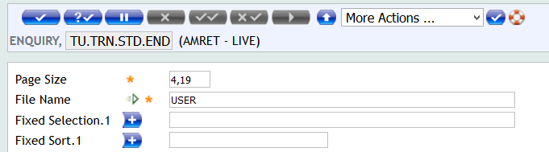
Enquiry Customization (Cont.)
• Enquiry Design Procedure
A. STANDARD ENQUIRY
1. Define the ENQUIRY @ID
2. Choose a T24 data table as the main data source and define it in the ENQUIRY table

Slide 17
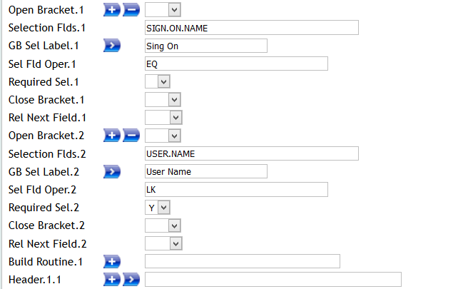
Enquiry Customization (Cont.)
3. Decide the SELECTION CONDITION fields from the main T24 data table

Slide 18
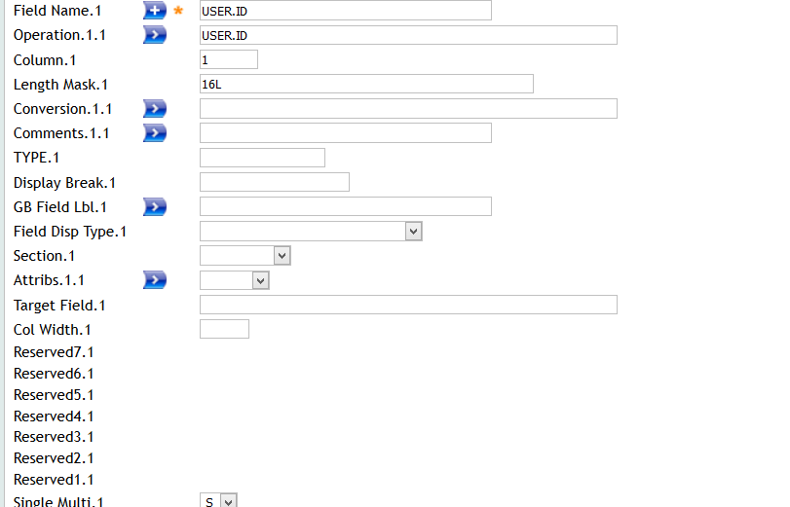

Enquiry Customization (Cont.)
4. Set up the required ENQUIRY field for displaying the data on the screen
5. Test the basic standard ENQUIRY

Slide 19
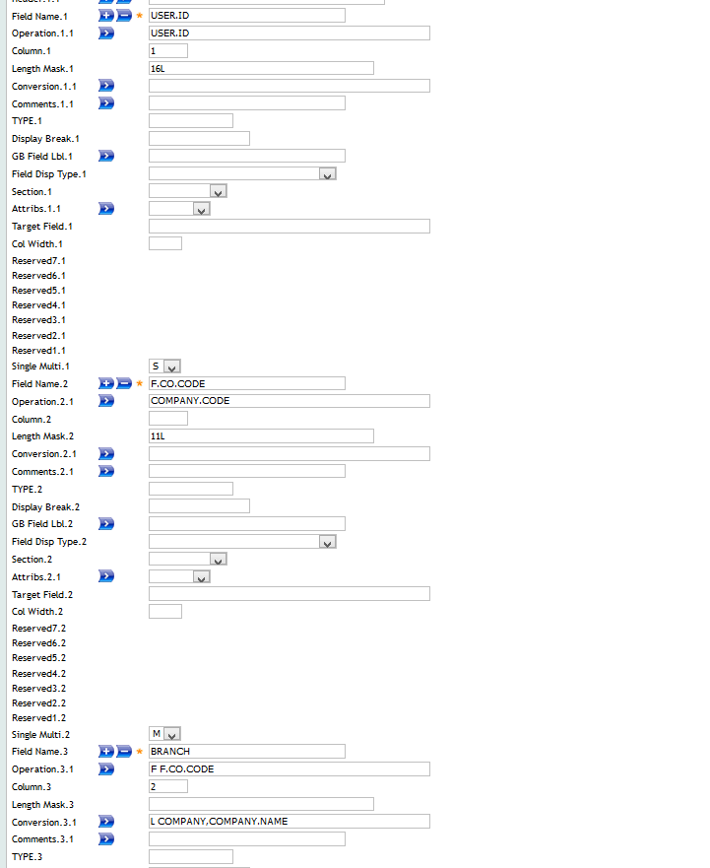
Enquiry Customization (Cont.)

Slide 20
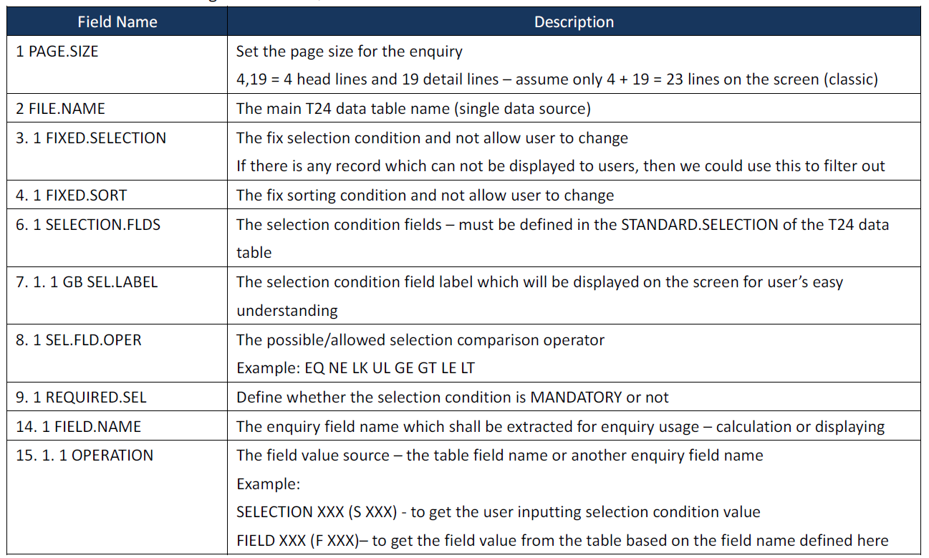
Enquiry Customization (Cont.)
b. The field definition & usage on the ENQUIRY

Slide 21
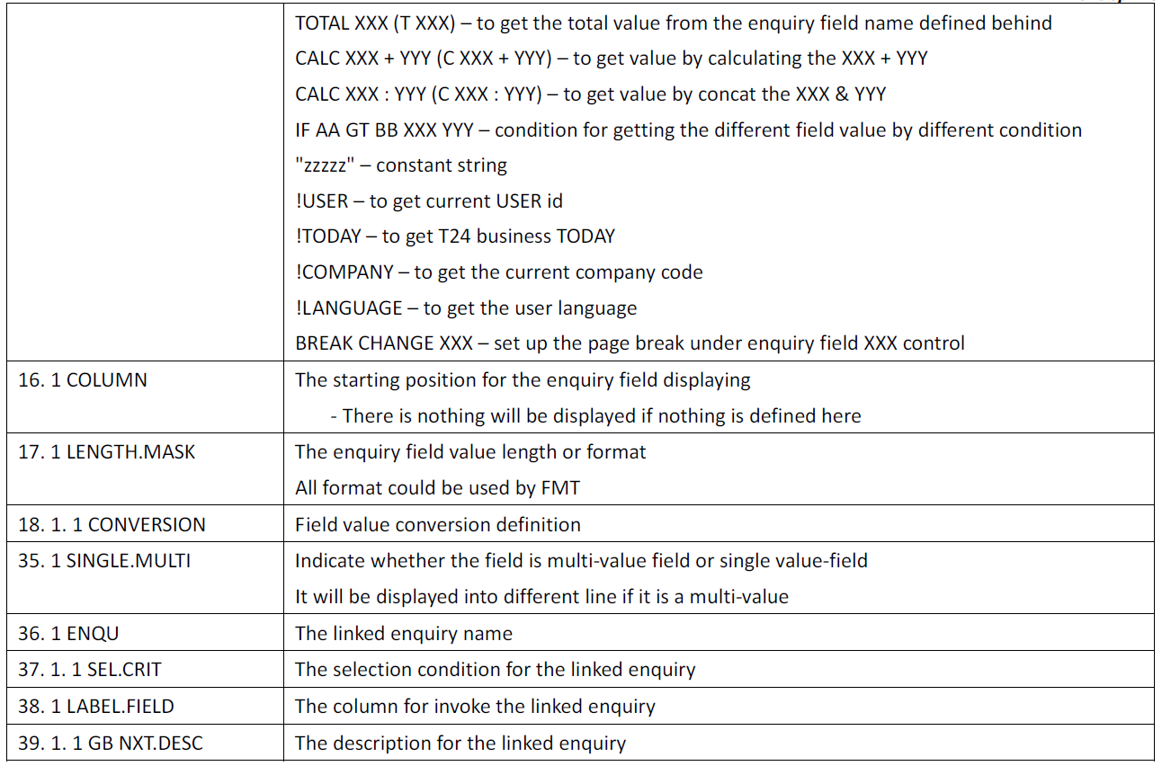
Enquiry Customization (Cont.)

Slide 22
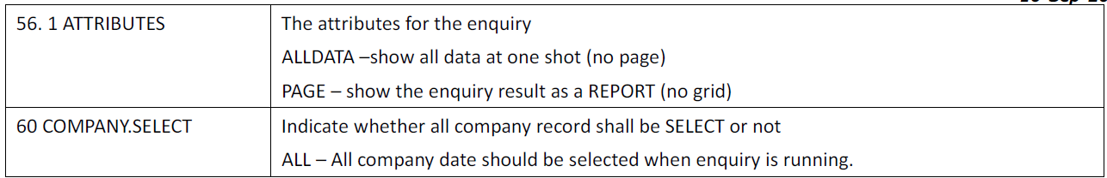
Enquiry Customization (Cont.)

Slide 23
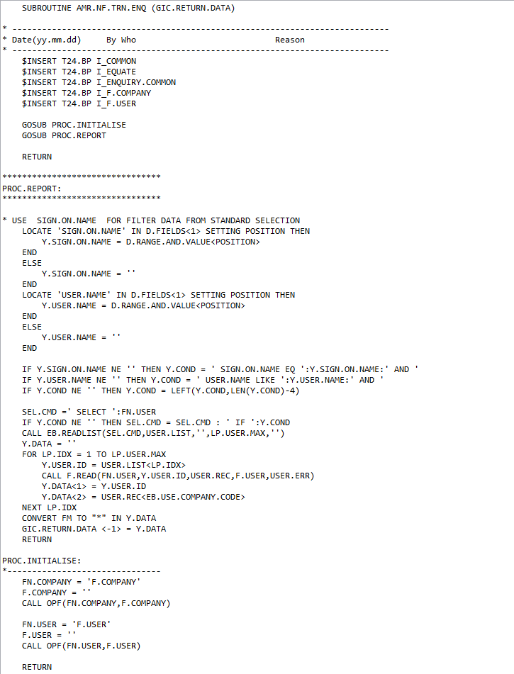
Enquiry Customization (Cont.)
B. NOFILE Enquiry
1. Routine must return data set

Slide 24
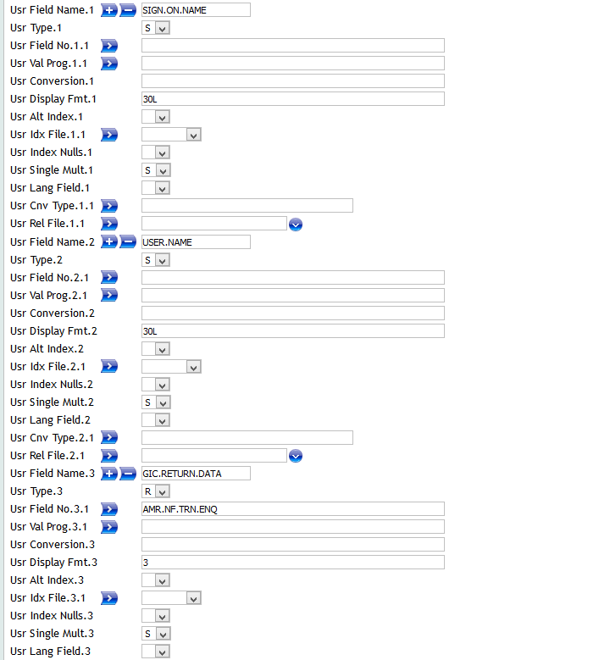

Enquiry Customization (Cont.)
2. Define STANDARD.SELECTION
The @ID of Standard.selection must start from prefix: NOFILE.XXX

Slide 25

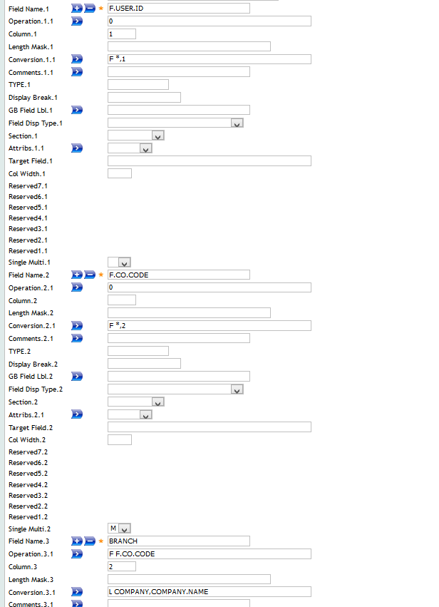
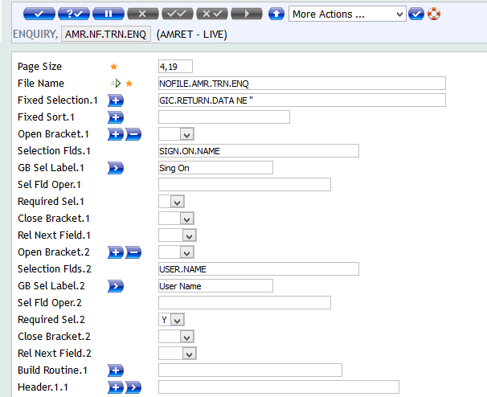
Enquiry Customization (Cont.)
3. Design Enquiry

Slide 26
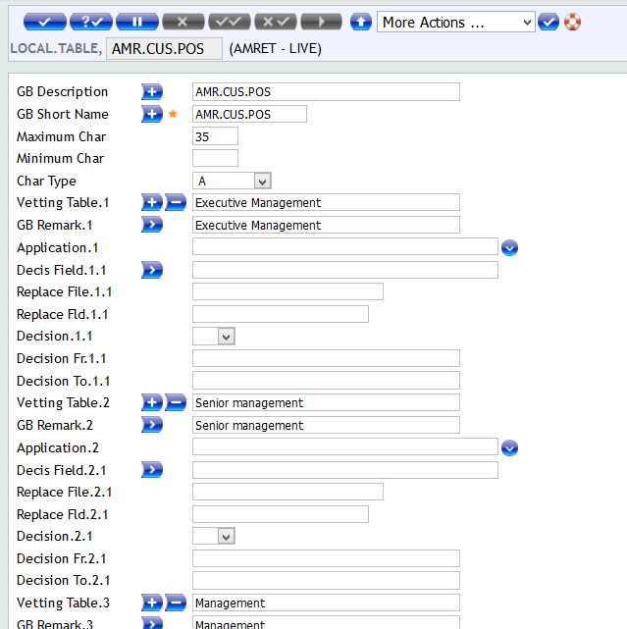
Version Customization
LOCAL.TABLE
This table allows the specific details of such fields to be defined, including, the name of the Input field, the minimum and maximum number of characters, the type of characters, all possible Input values and whether the Input is to be Validated against the key of another table.

Slide 27
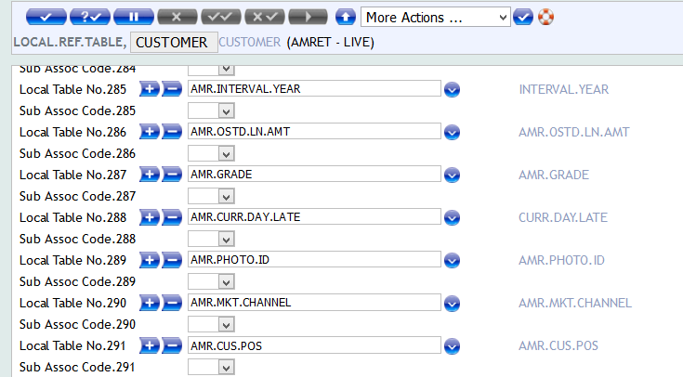
Version Customization (Cont.)
2. LOCAL.REF.TABLE
The purpose of this table is to specify the names of any Applications that are to include any previously defined Local Table elements as Input fields and the order in which they are to appear on the screen.

Slide 28
Version Customization (Cont.)
3. Why we need the VERSION?
. For arranging a screen which make data entry becomes an easier task
. Provide different functions on top of original APPLICATION – like validation/log data providing - in different version
4. The major features for VERSION
. Arrange the field position and label
. Set the default value for easier data entry
. Validate the user inputting
. Extra data log and system update
. Linked action execution

Slide 29
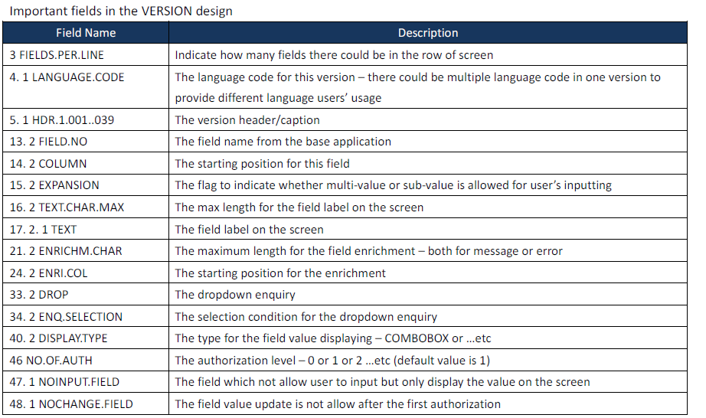
Version Customization (Cont.)

Slide 30
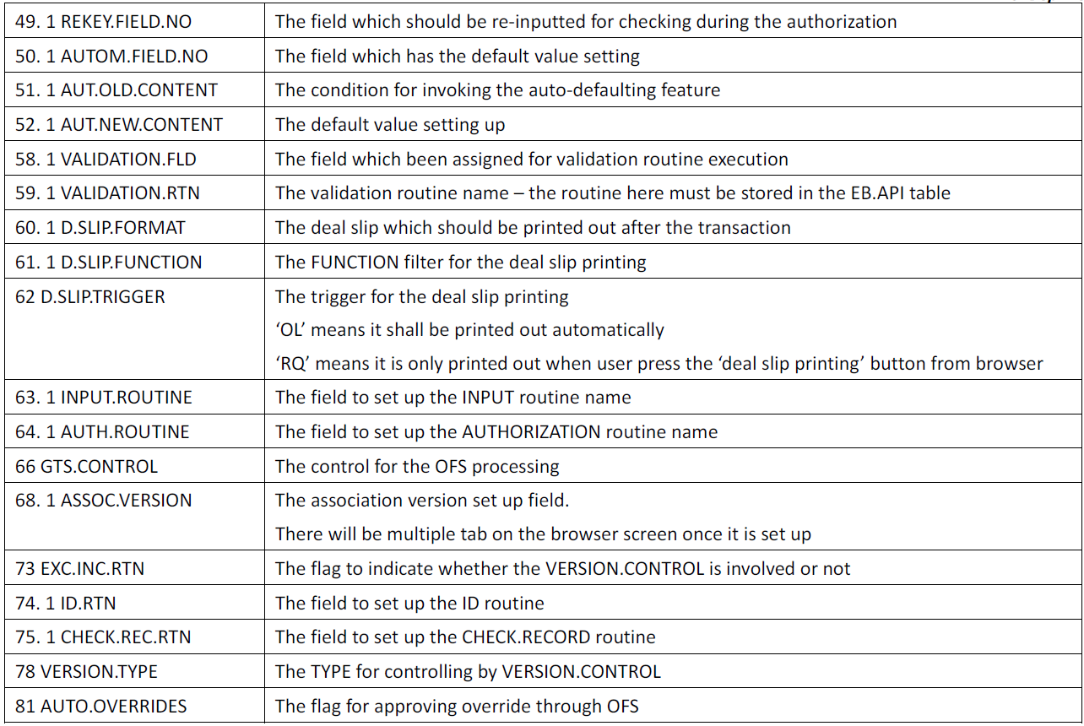
Version Customization (Cont.)

Slide 31
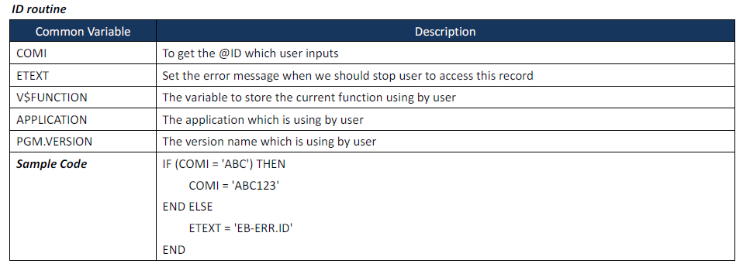
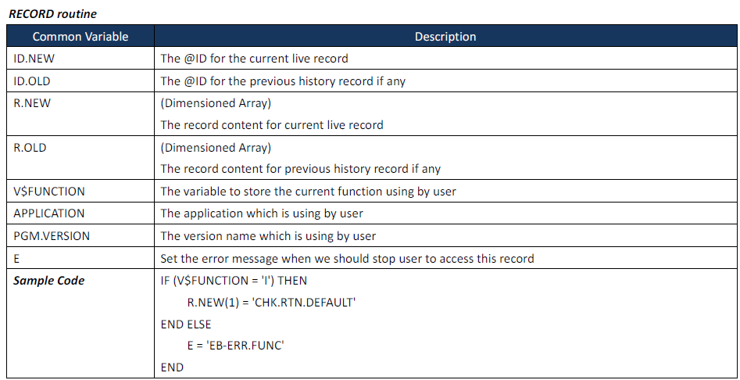
Version Customization (Cont.)

Slide 32
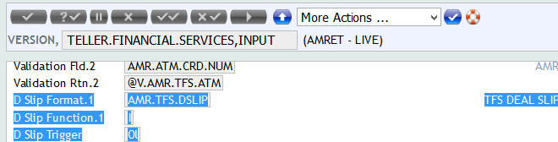
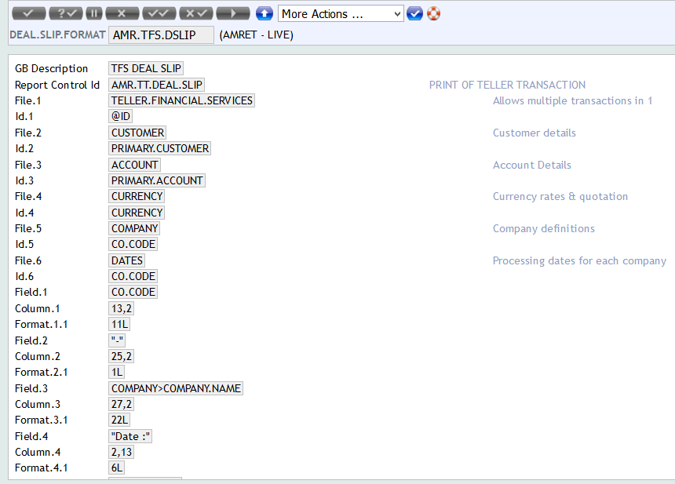
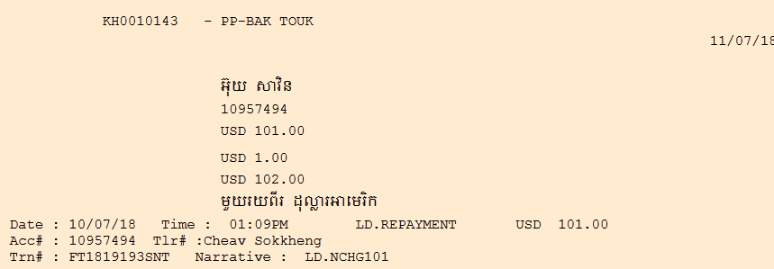
DEAL.SLIP.FORMAT Customization

Slide 33
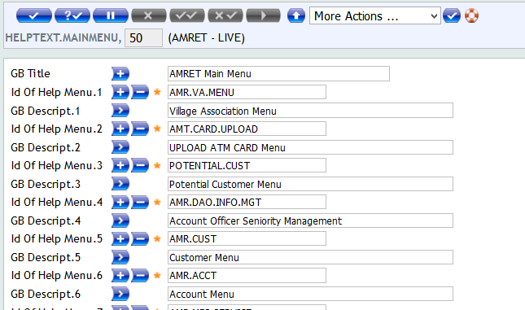
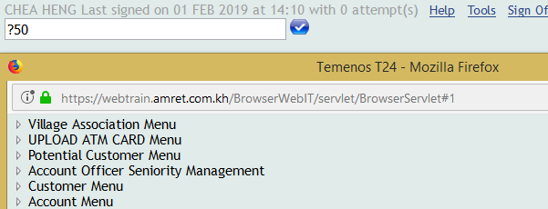
HELPTEXT.MAINMENU Customization

Slide 34
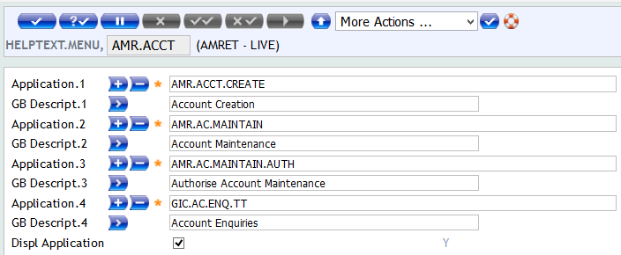
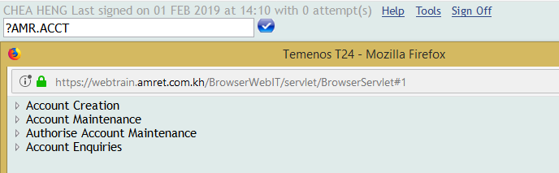
HELPTEXT.MENU Customization

Slide 35
Batch Job Customization
T24 Batch Overview
. TSM & TSA
What is TSM & TSA?
TSM stands for ‘Temenos Service Manager’
TSA stands for ‘Temenos Service Agent’
What is relationship between TSM & TSA?
TSM is the manager of TSAs.
TSM will control the job status and instruct TSA to execute the correct job till all jobs required
are complete.
Whether we could run the BATCH job without TSM?
NO, it is not possible to execute the COB job without the TSM.
What is the major task for TSM?
TSM is just a manager to monitor all TSA status and start the TSA if it is died.

Slide 36
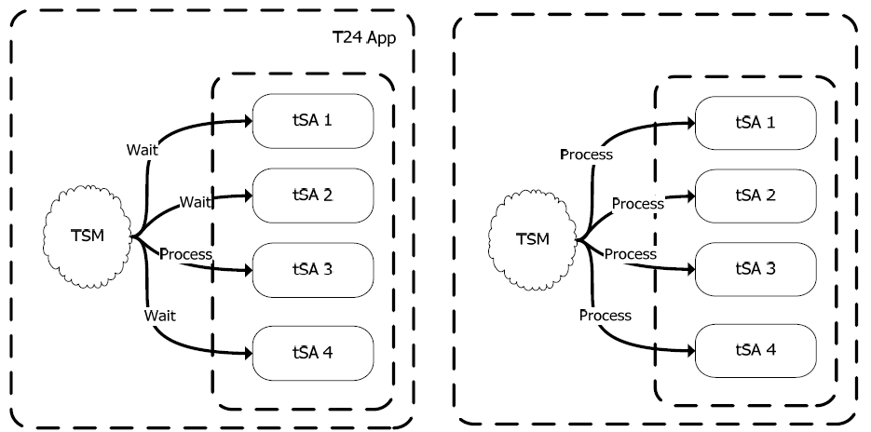
Batch Job Customization (Cont.)
• Batch Job Flow
a. The execution mode comparison for single thread batch & multi-thread batch?

Slide 37
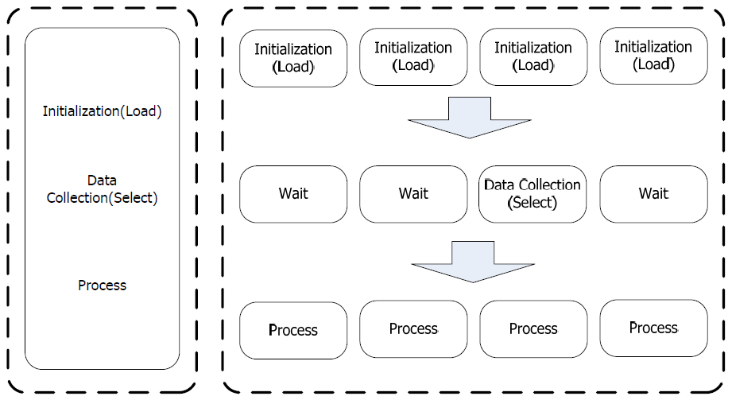
Batch Job Customization (Cont.)
b. The difference on real processing for the single thread and multi-thread batch?

Slide 38
Batch Job Customization (Cont.)
• Single Thread Batch Code
a. The procedure to configure the T24 single thread batch job
1. Write a empty single thread subroutine
2. Compile the routine – EB.COMPILE EXC.B TU.B.SNG.THRD.S

Slide 39
Batch Job Customization (Cont.)
3. Logoff and Logon System
4. Logon T24 and Set up the EB.API
5. Set up the PGM.FILE @ID=TU.B.SNG.THRD.S
The field 4. 1 BATCH.JOB value MUST be ‘@XXXXXXXXXX’
‘XXXXXXXXXX’ is the single thread subroutine name

Slide 40
Batch Job Customization (Cont.)
6. Set up the BATCH @ID=BNK/SNG.THRD.TRN
The job name must be the same as the @ID in the PGM.FILE
7. Set up the TSA.SERVICE @ID=BNK/SNG.THRD.TRN (The @ID must be the same as the @ID in the BATCH)

Slide 41
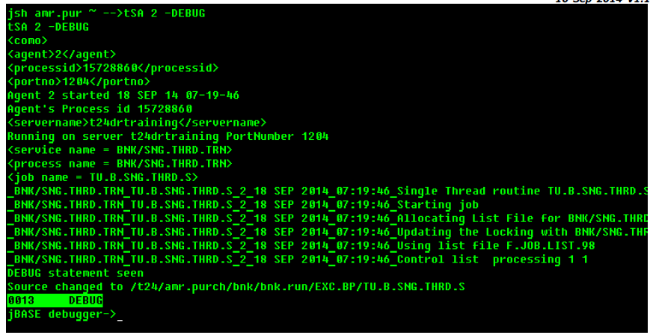
Batch Job Customization (Cont.)
8. Do the batch testing to make sure all configurations are done properly before the coding.

Slide 42
Batch Job Customization (Cont.)
• Multi-Thread Batch Code
a. The procedure to configure the T24 multi-thread batch job
1. Write a empty multi-thread thread subroutine
There are 4 parts for a multi-thread subroutine
a. COMMON file – Declare the common variables which should be shared between
LOAD & SELECT & Main
b. LOAD routine – The variable initialization (open file and initialize all common
variables)
c. SELECT routine – The real data collection work and CALL BATCH.BUILD.LIST to store
the collected data
d. Main routine – The main processing routine which get KEY from the selection
routine and complete the task

Slide 43
Batch Job Customization (Cont.)

Slide 44
Batch Job Customization (Cont.)

Slide 45
Batch Job Customization (Cont.)

Slide 46
Batch Job Customization (Cont.)
2. Compile the 3 routines – TU.B.MULT.THRD.LOAD & TU.B.MULT.THRD.SELECT & TU.B.MULT.THRD

Slide 47
Batch Job Customization (Cont.)
3. Define the EB.API @ID=TU.B.MULT.THRD.TRN
4. Define the PGM.FILE @ID=TU.B.MULT.THRD.TRN

Slide 48
Batch Job Customization (Cont.)
5. Define the BATCH record @ID=BNK/MULT.THRD.TRN
6. Define the TSA.SERVICE @ID=BNK/MULT.THRD.TRN

Slide 49
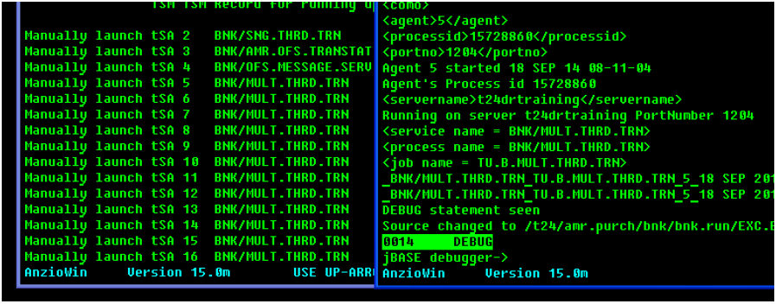
Batch Job Customization (Cont.)
7. Do the testing on the multi-thread program

Slide 50

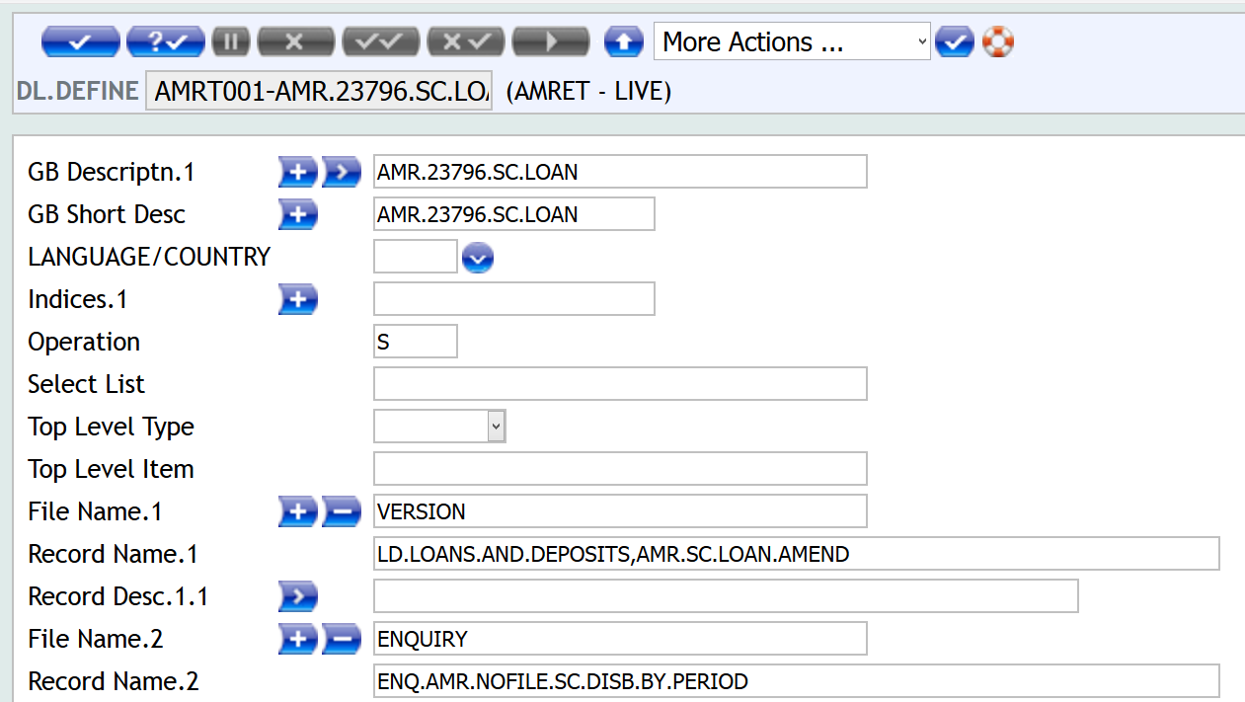
Build & Deploy Package
DL.DEFINE

Slide 51
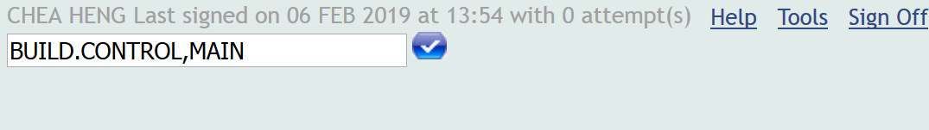
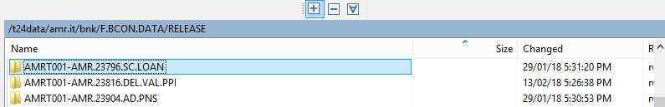
Build & Deploy Package (Cont.)
2. BUILD.CONTROL,MAIN

Slide 52
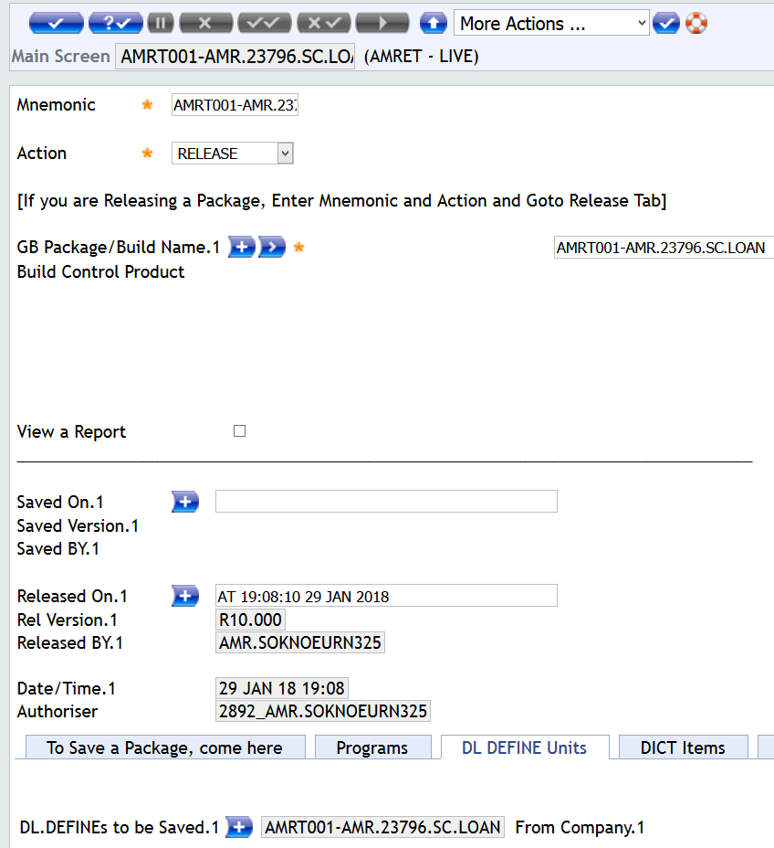
Build & Deploy Package

Slide 53
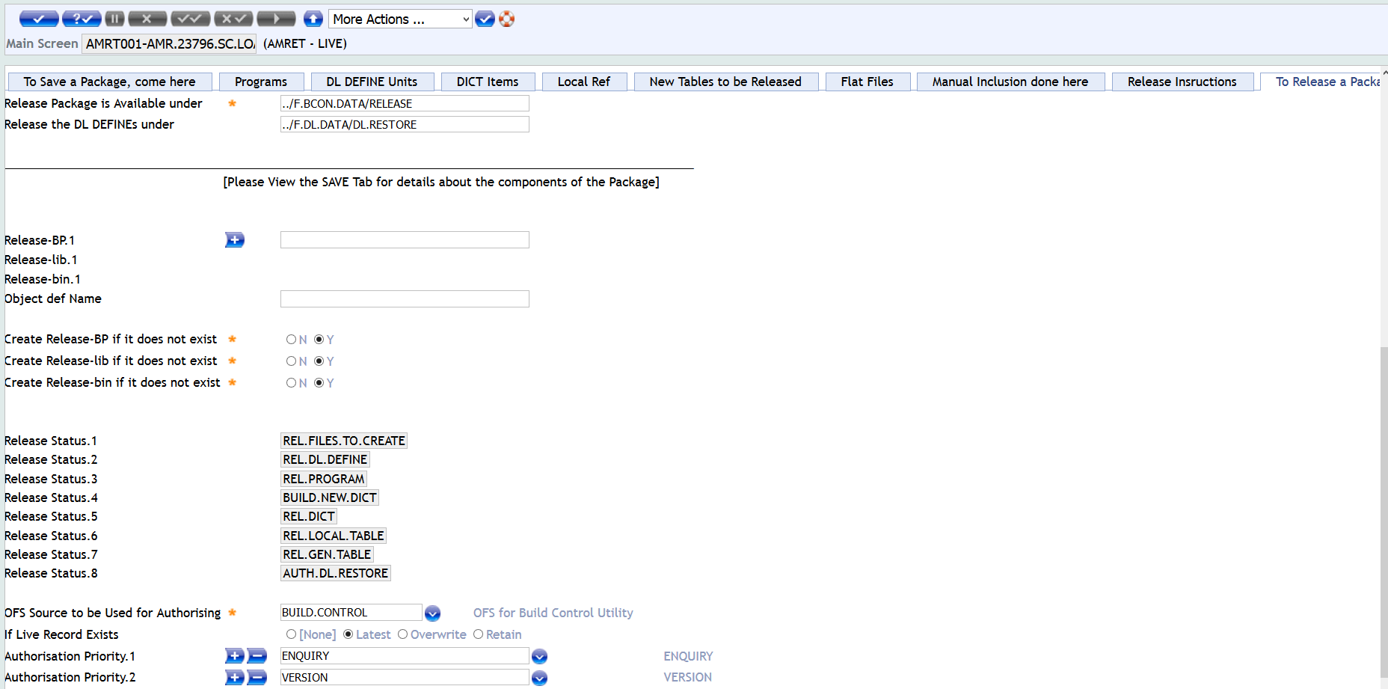
Build & Deploy Package(Cont.)

Slide 54
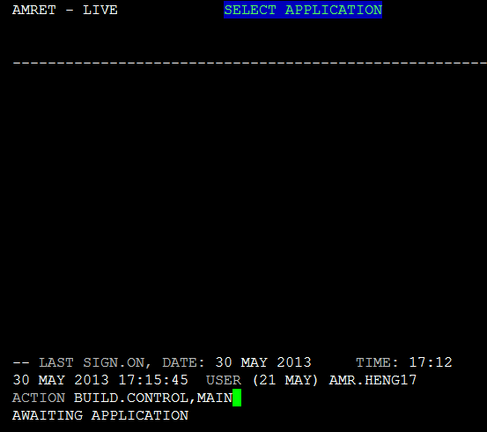
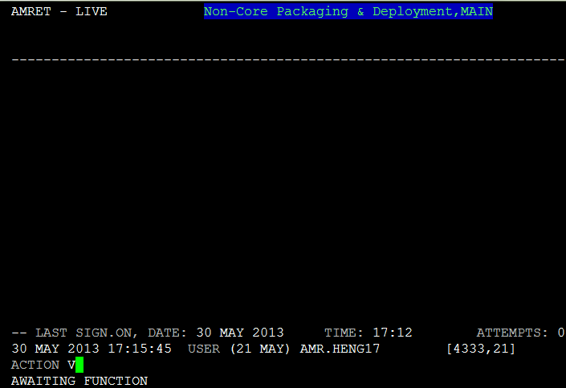
Build & Deploy Package(Cont.)

Slide 55
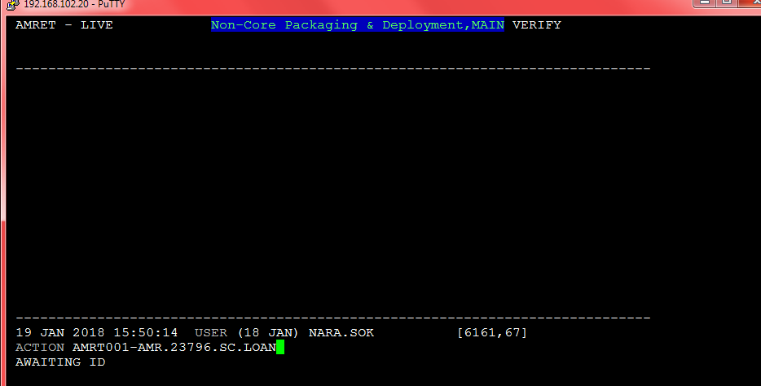
Build & Deploy Package(Cont.)

Slide 56
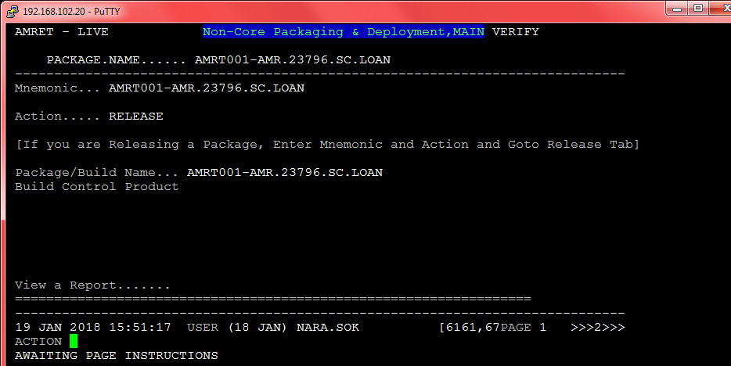
Build & Deploy Package(Cont.)

Slide 57
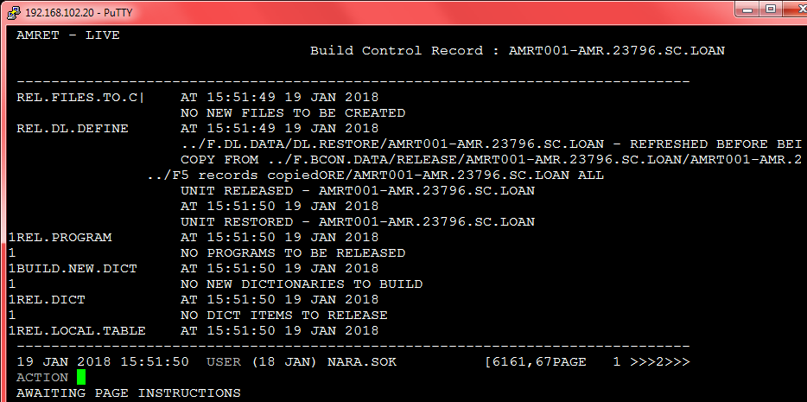
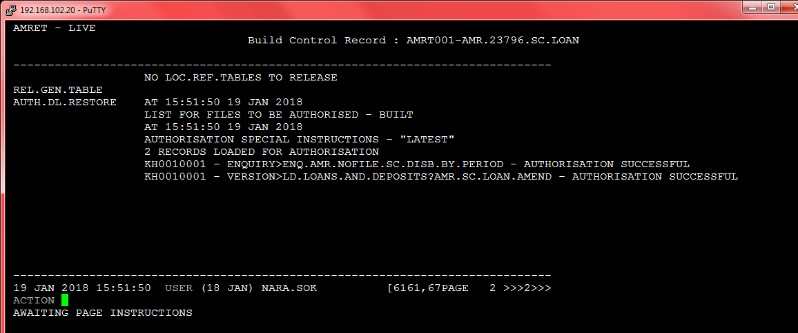
Build & Deploy Package(Cont.)

Slide 58
T24 System Configuration
Basic system concat file introduction
. CUSTOMER.ACCOUNT
. CATEG.INT.ACCT
. CONSOLIDATE.COND
. CONSOLIDATE.ASST.LIAB
. CONSOLIDATE.PRFT.LOSS
. EB.CONTRACT.BALANCES
. RE.CONSOL.CONTRACT
. RE.STAT.LINE.CONT
. STMT.ENTRY
. CATEG.ENTRY

Slide 59
Open Financial Service (OFS), develop API
A.OFS Introduction and Structure (Open Financial Service)
-Transaction Request
APPLICATION,VERSION/COMMAND/SUBCOMMAND,USER/PASSWORD,ID,DATA
Part | Meaning
APPLICATION | T24 application (ex: CUSTOMER). This is something like a table in database
VERSION | Application version. This is like a stored procedure through which data goes into defined APPLICATION
COMMAND | I = INPUT, A = AUTHORIZE, S = SEE, D = DELETE, R = REVERS, V = VERIFY
SUBCOMMAND | PROCESS = process, VERIFY = verify only
USER | login for Т24
PASSWORD | password
ID | ID of the row of application
DATA | Data. If INPUT then format: COLUMN:X:Y=VALUE, where X - multivalue, Y - subvalue. So one column could have several values. For example CUSTOMER.NAME in English and in Local language: NAME:1:="DMITRY",NAME:2:="ДМИТРО"

Slide 60
Open Financial Service (OFS), develop API
FUNDS.TRANSFER,MFS.CASH.DEPOSIT/I/PROCESS,AMRMFS/******/KH0010208,/DPS4007181225073834,AGENT.ID::=4007,CREDIT.CURRENCY::=KHR,CREDIT.ACCT.NO::=13883866,DEBIT.CURRENCY::=KHR,DEBIT.ACCT.NO::=KHR1011040070208,DEBIT.AMOUNT::=20000,ORDERING.CUST::=1443493
Enquiry Request
ENQUIRY.SELECT,,USER INFORMATION,ENQUIRY,Message Data (comma separated)
Example:
ENQUIRY.SELECT,,HENG17/168$$chOK/KH0010206,%ACCOUNT,@ID:EQ=7786417
@ID::Account Id/LEG.ACCT.NO::LEGACY NUM/SHORT.TITLE::SHORT.TITLE/ACCOUNT.TITLE.1::Accout Title1/MNEMONIC::Mnemonic/ACCOUNT.OFFICER::Account Officer/CATEGORY::Product/CURRENCY::Ccy/ONLINE.ACTUAL.BAL::Online Actual Bal/LIMIT.REF::Limit Ref/POSTING.RESTRICT::Posting Restrict/INT.NO.BOOKING::Int Booking/CONDITION.GROUP::Condition Group/CATEGORY::Product/ALT.ACCT.ID::ALT.ACCT.ID," 7786417" " " "áá
á áááá " "Porng Yeth " " " "Chek Sokho" "Happy Account " "USD" " 7,416.83" " " " " " " " 1" " 6400" "

Slide 61
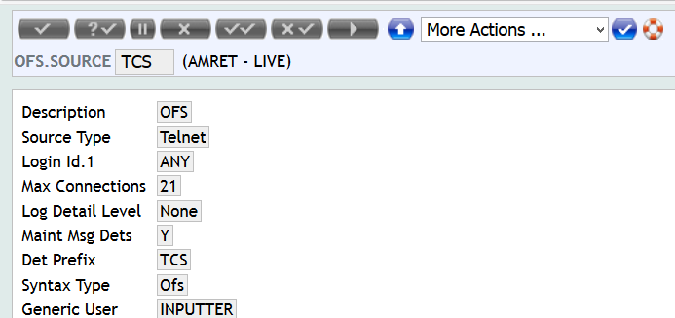
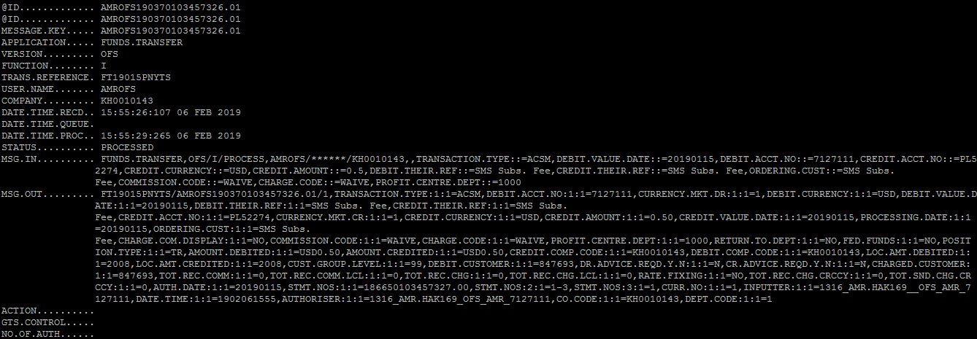
Open Financial Service (OFS), develop API
OFS.SOURCE
OFS.REQUEST.DETAIL

